Slide 1
IOT Based River Water Quality Monitoring System
TEAM CHALLENGERS

Slide 2
Theme of the project
Generally we know that river water is used for different purposes like agriculture is one of the best example
But we don’t know that whether the water is suitable for the farming or not
So with the help of this project we can monitor different parameters of water like ph value, turbidity value and temperature value

Slide 3
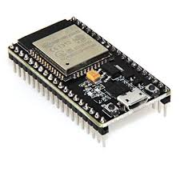
HARDWARES
ESP32
Turbidity sensor
Temperature sensor
Ph sensor

Slide 4


SOFTWARES and SERVICES
Arduino IDE
IBM cloud
Node Red
MIT app Inventor

Slide 5
ESP32 Features
Two independently-controlled CPU cores with adjustable clock frequency, ranging from 80 MHz to 240 MHz
+19.5 dBm output at the antenna ensures a good physical range
Classic Bluetooth for legacy connections, also supporting L2CAP, SDP, GAP, SMP, AVDTP, AVCTP, A2DP (SNK) and AVRCP (CT)
Support for Bluetooth Low Energy (BLE) profiles including L2CAP, GAP, GATT, SMP, and GATT-based profiles like BluFi, SPP-like, etc
Bluetooth Low Energy (BLE) connects to smart phones, broadcasting low-energy beacons for easy detection
Sleep current is less than 5 μA, making it suitable for battery-powered and wearable-electronics applications
Integrates 4 MB flash
Peripherals include capacitive touch sensors, Hall sensor, low-noise sense amplifiers, SD card interface, Ethernet, high-speed SPI, UART, I2S and I2C
Fully certified with integrated antenna and software stacks

Slide 6
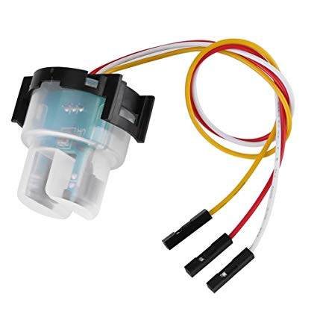
Turbidity sensor
Turbidity sensors measure the amount of light that is scattered by the suspended solids in water. As the amount of total suspended solids (TSS) in water increases, the water's turbidity level (and cloudiness or haziness) increases.

Slide 7
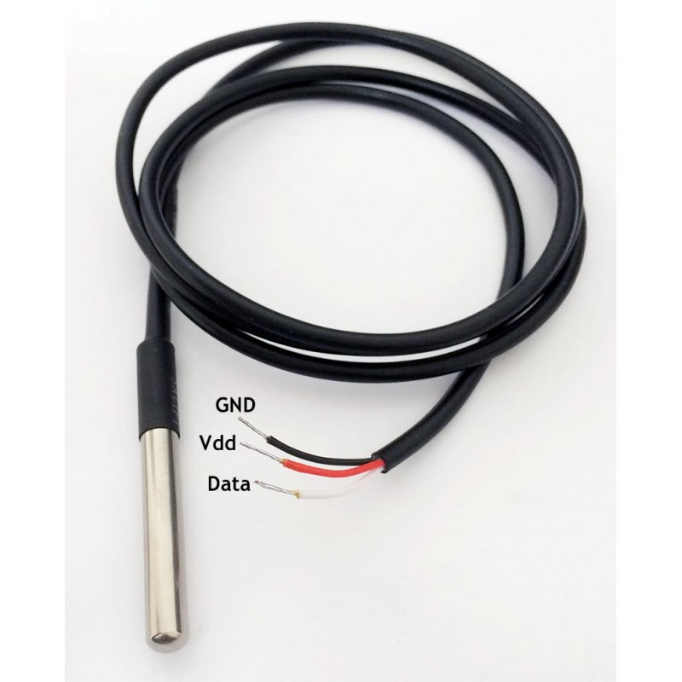
Temperature sensor
This sensor is mainly used to monitor the temperature of the water(DS18B20) the working is almost same as the LM-35 sensor
Range is -55 to 125 *c
This is digital type sensor

Slide 8
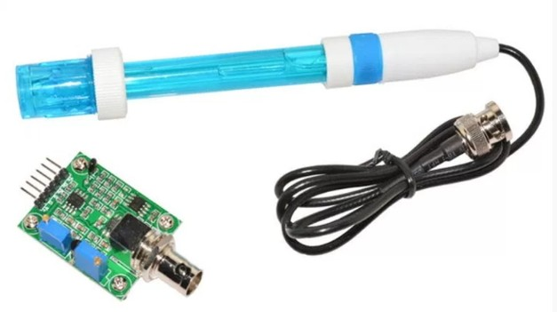
Ph sensor
pH, commonly used for water measurements, is a measure of acidity and alkalinity, or the caustic and base present in a given solution. It is generally expressed with a numeric scale ranging from 0-14. The value 7 represents neutrality. The numbers on the scale increase with increasing alkalinity, while the numbers on the scale decrease with increasing acidity.

Slide 9
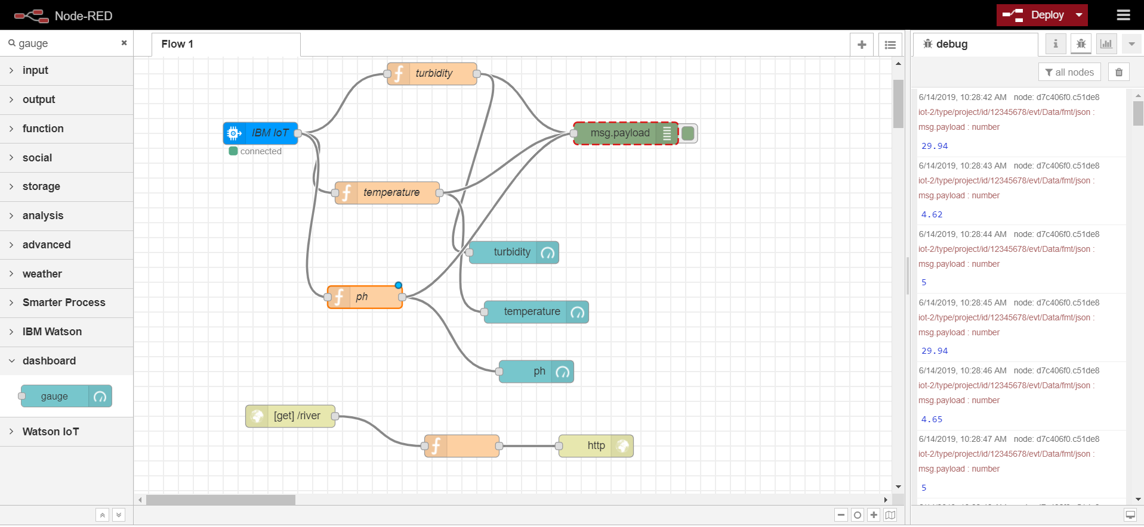
NODE-RED FLOW

Slide 10
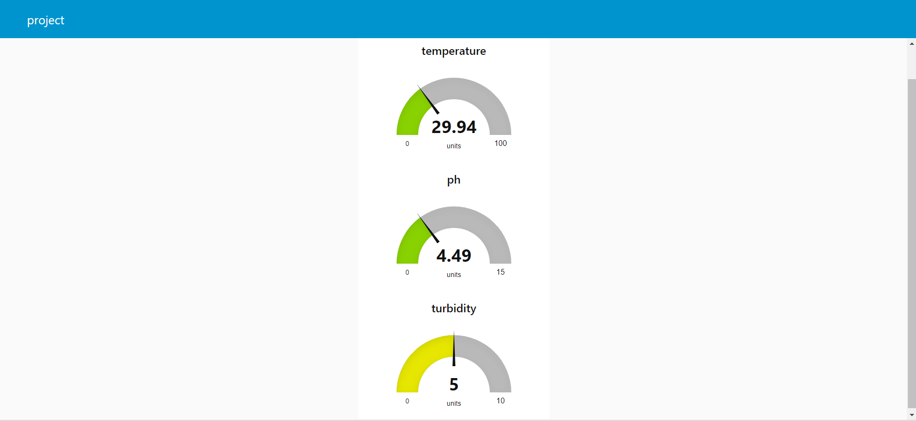
OUTPUTS

Slide 11
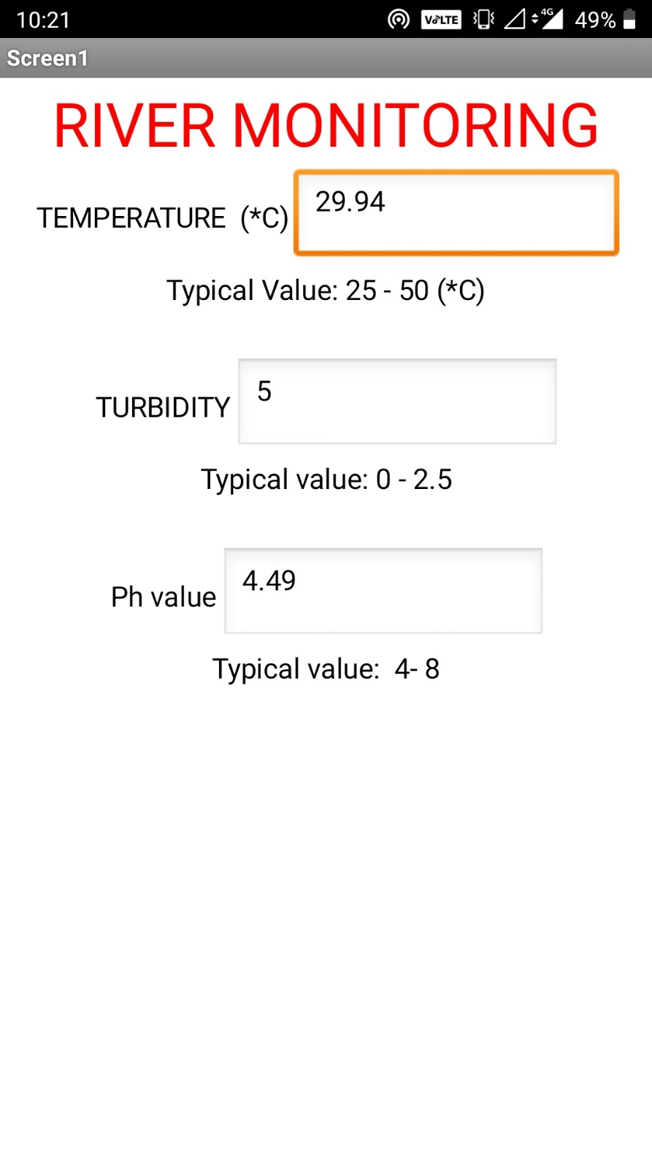

Slide 12
Advantages
The system can monitor water quality automatically
It is low in cost and doesn’t require people duty
So water quality testing is likely to be economical, convenient and fast
By this project it is very easy to know the water quality and we can easily figure it out that it can be used for agriculture or drinking puposes by the parameters known

Slide 13
FUTURE SCOPE
Detecting more parameters like dissolved oxygen for most secure purpose
Increase the parameters by addition of multiple sensors
By interfacing relay we can control the supply of water

Slide 14


